Slide 1
— COSC3126 Data Mining Assignment 3: Course Project "Naïve Bayes, Ensemble Learning, and E-commerce Behavior"
Chau Le Hoang (s3715228@rmit.edu.vn)
Hung Ha Quoc (s3926578@rmit.edu.vn)
Nguyen Khac Bao (s4139514@rmit.edu.vn)
2025 - RMIT University Vietnam, Saigon South Campus

Slide 2
Agenda
AI Avenger: Hoang
Team Introduction
Dataset Overview
Naïve Bayes on Obesity Dataset
Bayesian Sentiment Analysis
Defining Tasks (Shopper Dataset)
Advanced Data Mining Techniques
Innovative Technique (Hybrid Ensemble)
Key Conclusions & Recommendations
Q&A

Slide 3
— Introduction

Slide 4



Group 2
Hoang
Hung
Bao

Slide 5
— Naïve Bayes on Obesity Dataset

Slide 6
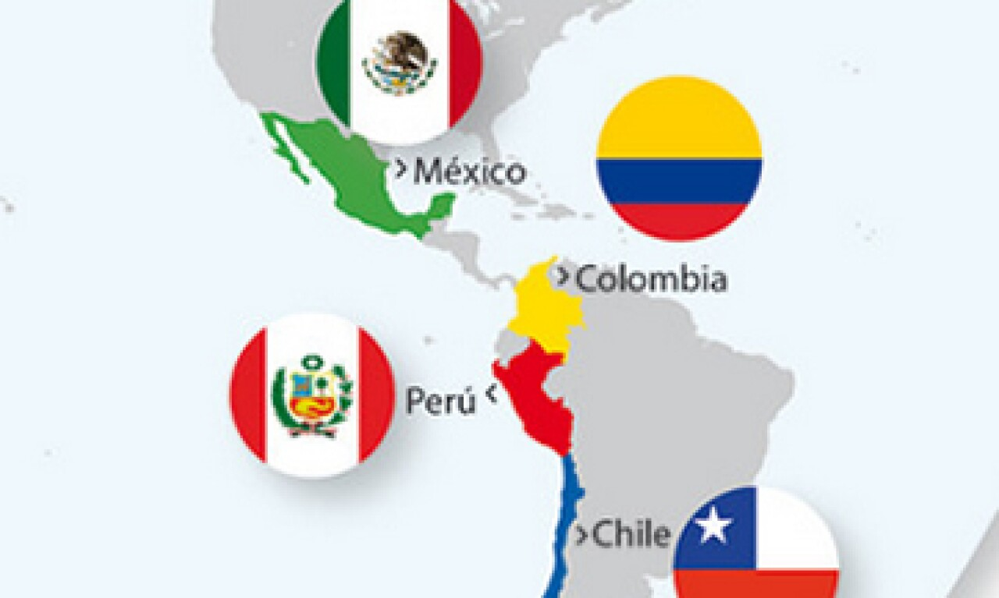
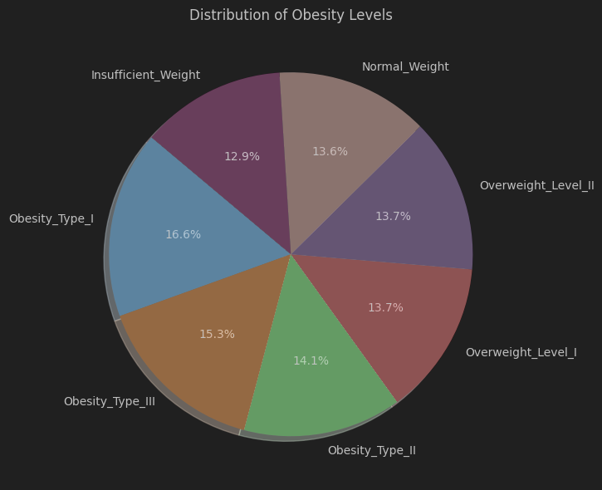
Obesity Level Estimation Dataset
AI Avenger: Hoang
Collected from Mexico, Peru, Colombia
2,111 records, 17 attributes, no missing values
Target: NObeyesdad (7 obesity levels: Insufficient to Obesity III)
Numeric: Age, Weight, Height, meal & activity data
Categorical: Gender, transport, smoking, family history
77% synthetic data (via SMOTE for class balancing)
source: https://expansion.mx/economia/2014/02/07/la-alianza-del-pacifico-en-numeros
Notes:
This dataset includes information from individuals in Mexico, Peru, and Colombia, collected to help predict a person’s obesity level based on their lifestyle and physical attributes.
There are 2,111 records, and each record has 17 attributes — a mix of numerical features like age, height, and weight, and categorical ones like gender, transportation type, smoking habits, and family history of obesity.
The target variable is NObeyesdad, which classifies individuals into seven categories, from Insufficient Weight to Obesity Type III. You can see these categories represented in the pie chart on the right, which gives a snapshot of the class distribution.
One important note: around 77% of the data was synthetically generated using a method called SMOTE — this was done to balance the class distribution and avoid bias in the learning process.
Because this dataset has both real-world data and synthetically balanced classes, it's a great candidate for evaluating machine learning models — especially in healthcare-related applications where early prediction is valuable.”

Slide 7
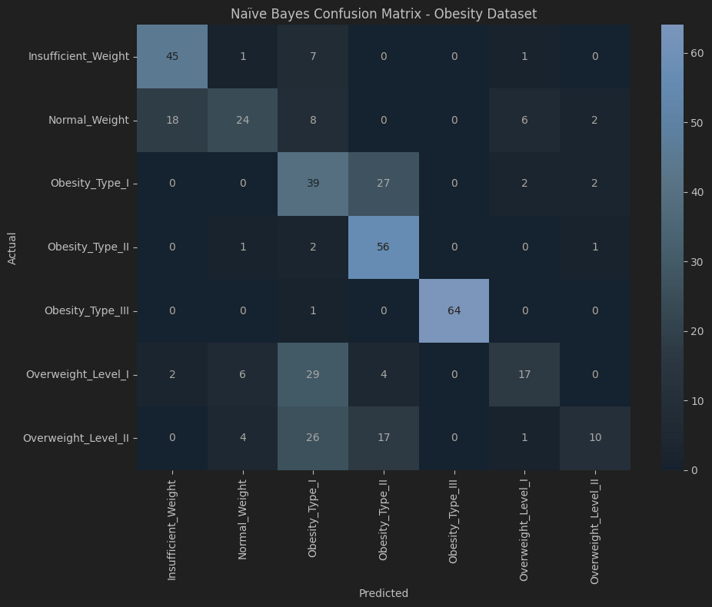
Naïve Bayes for Classification
AI Avenger: Hoang
Dataset: 7 obesity classes (e.g., Normal, Obesity II, etc.)
Baselines:
OneR: 16.5% accuracy
J48 (Decision Tree): 93.6% accuracy
Naïve Bayes:
Accuracy: 60.3%
Strong for Obesity Type I (F1 = 0.99)
Weak for Obesity Type III due to overlapping features
Notes:
While this is a strong simplifying assumption, it allows Naïve Bayes to be very fast and interpretable.
After encoding the categorical features and splitting the data into training and test sets, we trained a Gaussian Naïve Bayes model.
On this dataset, Naïve Bayes achieved an accuracy of 60.3%, which is decent but not high — especially for a 7-class problem.
We dug deeper by looking at the confusion matrix, which is shown here on the slide. It highlights that the model was particularly strong in predicting Obesity Type I, where it achieved a very high F1 score.
However, it struggled with distinguishing between similar or adjacent classes, such as Overweight I vs II, or Obesity Type II vs III.
The F1 score table on the slide confirms this. Some classes show strong performance, while others — especially those with subtler feature differences — are harder to predict correctly.
This highlights a key limitation of Naïve Bayes: while it’s fast and simple, its independence assumption doesn’t hold well for medical data, where many variables are often correlated — for example, weight, BMI, and exercise frequency.”

Slide 8
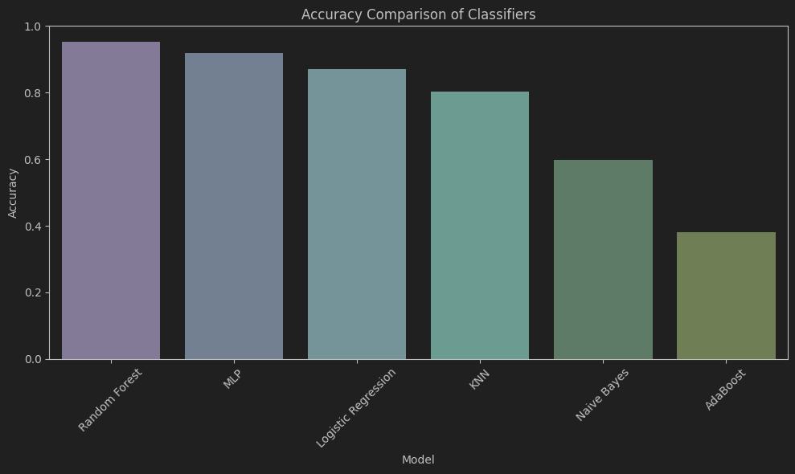
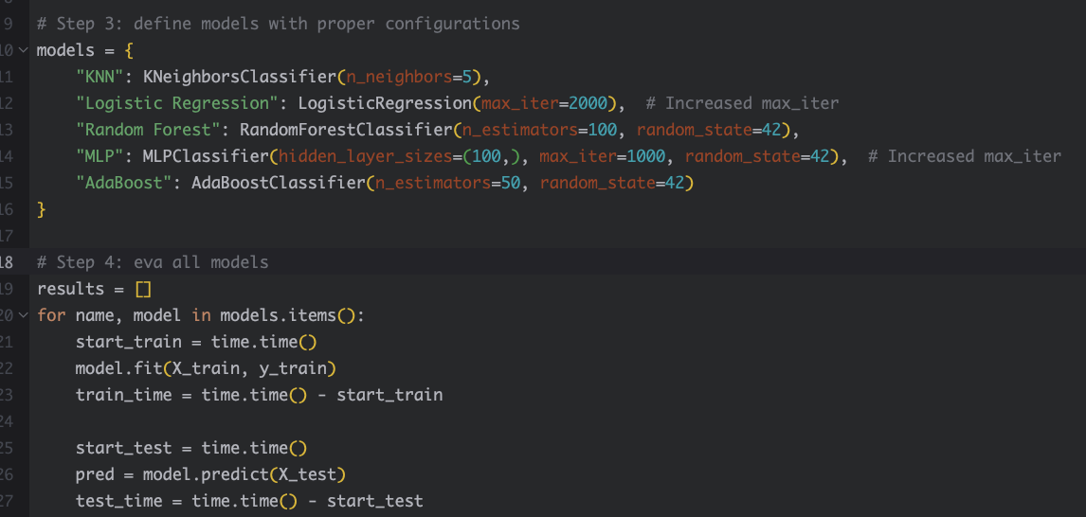
Comparing Naïve Bayes with ML Models
AI Avenger: Hoang
Models compared: RF, KNN, Logistic Regression, MLP, AdaBoost
Best model: Random Forest (95.3%)
Takeaway:
Naïve Bayes (NB) is interpretable and fast
Not suitable where feature independence is violated
Notes:
As you can see in the bar chart on this slide, Random Forest clearly outperformed all others, achieving over 95% accuracy — likely due to its ability to capture feature interactions and non-linear boundaries.
MLP and KNN also performed well, followed by Logistic Regression.
Naïve Bayes, on the other hand, had the lowest accuracy, reflecting its limited capacity to handle multi-class, correlated-feature scenarios.
This comparison reinforces a key point:
While Naïve Bayes is simple, fast, and interpretable, it often gets outperformed by more complex models that can handle feature interactions and class imbalances more effectively.
However, that doesn’t mean Naïve Bayes is useless.
It’s still valuable in early prototyping, or when computational speed and simplicity are more important than raw accuracy — especially in embedded or mobile systems.”

Slide 9
— Bayesian Sentiment Analysis

Slide 10
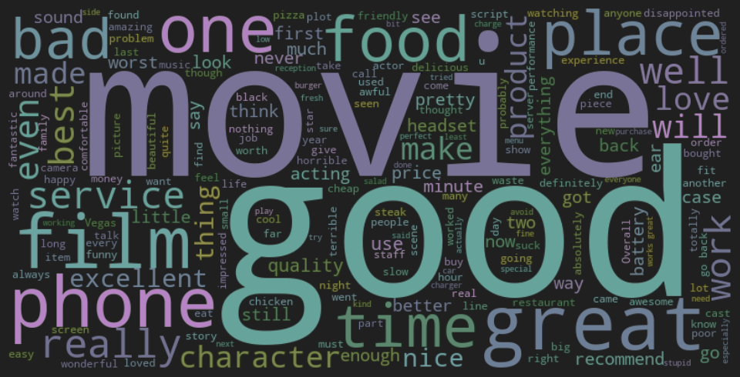
Sentiment Dataset & Feature Engineering
AI Avenger: Hung
3,000 English reviews from:
Amazon, IMDb, Yelp
Balanced: 1,500 positive, 1,500 negative
Preprocessing Steps:
Text cleaned and merged
Bag-of-Words (BoW): 1,632 binary attributes
Later experiments included:
TF-IDF weighting
N-gram tokenization
Limiting vocab to top 2,000 tokens
Word cloud of frequent tokens
Notes:
We started with basic text preprocessing, cleaning out punctuation and converting text to lowercase. Then, we used a Bag-of-Words approach, transforming each review into a binary vector that reflects the presence or absence of individual words. This gave us a total of 1,632 unique word-based features.
Later, we experimented with TF-IDF weighting, which prioritizes rare but meaningful terms, and also applied N-gram tokenization to capture short phrases instead of single words.
On the right, you’ll see a word cloud showing the most frequent words across the reviews. Words like “great”, “bad”, “love”, and “worst” clearly dominate — which is expected, since these are common in sentiment-heavy content.”

Slide 11
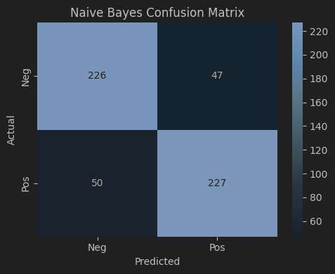
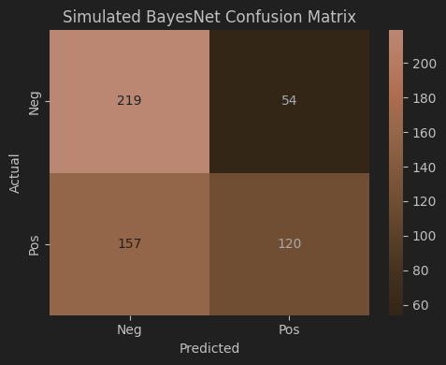
Comparing Naïve Bayes & BayesNet
AI Avenger: Hung
Base Configuration:
Naïve Bayes: 70.9% accuracy, ROC AUC 0.794
BayesNet: 68.3% accuracy, ROC AUC 0.738
ROC Insight:
NB → better at probability ranking
BayesNet → fewer false positives but misses positives
Confusion Tradeoff:
NB = more aggressive (higher recall)
BayesNet = more conservative (lower recall, fewer false alarms)
Notes:
Naïve Bayes performed quite well, achieving:
82.4% accuracy
And an AUC score of 0.889, which indicates strong separation between positive and negative classes.
We compared this to a simplified version of BayesNet, approximated using a shallow decision tree ensemble. That model achieved only 61.6% accuracy, and a significantly lower AUC of 0.657.
Looking at the confusion matrices:
Naïve Bayes correctly identifies most positive and negative reviews — especially good recall on positives.
In contrast, BayesNet was more conservative. It avoided false positives but also missed many actual positives — resulting in lower recall.
So, the takeaway is: Naïve Bayes is better suited when the cost of missing a positive sentiment is high, like in customer satisfaction analysis.”

Slide 12
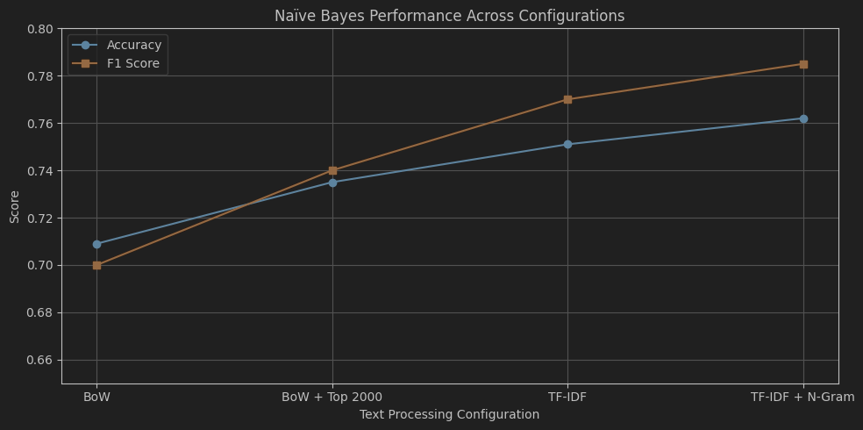
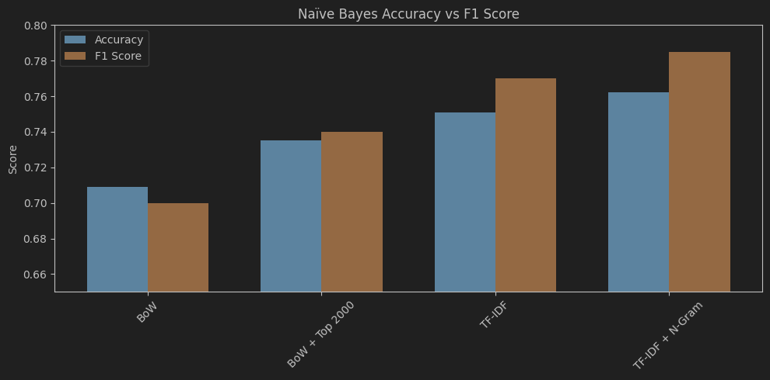
Effect of Tuning on Naïve Bayes
AI Avenger: Hung
Performance after tuning:
TF-IDF + N-Gram + Top 2,000 Words
Accuracy: 76.2%
Precision: 0.715, Recall: 0.870, F1: 0.785
Training Time: 1.81s
Test Time: 12.37s
BayesNet stagnated at ~67% accuracy despite tuning
Naïve Bayes benefits more from richer feature representation
Notes:
We tested four configurations:
A standard Bag-of-Words setup
Bag-of-Words with only the top 2,000 most frequent words
TF-IDF weighting, which balances term frequency across the dataset
TF-IDF combined with N-Grams, which captures short phrases like ‘not good’ or ‘very happy’
As shown in both the line chart and the bar chart, performance improved with each step:
Accuracy increased from 70.9% in the basic setup to 76.2% in the most advanced one
F1 Score improved from 0.70 to 0.785, indicating better balance between precision and recall
This shows that Naïve Bayes is very responsive to feature engineering. Even without complex models, carefully choosing how we represent text can lead to meaningful gains in accuracy and prediction quality.”

Slide 13
— Data Mining Using Advanced Techniques

Slide 14
Project Overview - The Dataset
AI Avenger: Bao
Dataset: Online Shoppers’ Intention Dataset (Sakar et al., 2019).
Origin: UCI Machine Learning Repository.
Scope:
12,330 sessions from a 1-year period.
Features include behavioral metrics (e.g., BounceRates, PageValues) and temporal context (e.g., proximity to special days).
Imbalanced classes: 84.5% sessions with no purchase, 15.5% sessions with a purchase.

Slide 15
Exploratory Data Analysis (EDA) Numerical Features
AI Avenger: Bao
Key Observations
ProductRelated:
Highly skewed, mean value of 32.05, maximum of 705 pages per session.
Outliers indicate sessions with intensive browsing.
ProductRelated_Duration: Skewed with durations reaching 63,973 seconds, highlighting extended browsing sessions.
BounceRates and ExitRates:
Concentrated near zero, showing low probabilities of session exits.
Strong positive correlation indicates higher exit likelihood with higher bounce rates.
PageValues: Positively correlated with revenue, indicating its significance in purchase behaviors.
SpecialDay: Non-zero values around holidays reveal increased user intent.
Insights for Modeling
Skewed distributions require robust scaling or transformations.
Handle outliers in ProductRelated_Duration and PageValues to ensure model stability.
Correlation between BounceRates and ExitRates suggests shared patterns in user disengagement.

Slide 16
Exploratory Data Analysis (EDA) Categorical Features
AI Avenger: Bao
Key Observations
Revenue: Significant class imbalance with 84.5% of sessions not resulting in purchases.
VisitorType: 85% of sessions initiated by returning visitors, indicating higher engagement potential.
Month: Peak activity observed in May, reflecting seasonal shopping trends.
Weekend: Fewer sessions recorded, showing stronger user engagement on weekdays.
TrafficType: Certain categories dominate, indicating the importance of targeted traffic sources.
Visual Insights
Feature Distributions: Histograms display the spread of ProductRelated and BounceRates.
Temporal Patterns: Line chart highlights monthly session activity trends.
Actionable Recommendations
Address Revenue class imbalance using techniques like SMOTE for balanced training.
Explore interaction terms (e.g., PageValues and ProductRelated_Duration) to enhance feature engineering.

Slide 17
— Advanced Models and Pattern Discovery

Slide 18
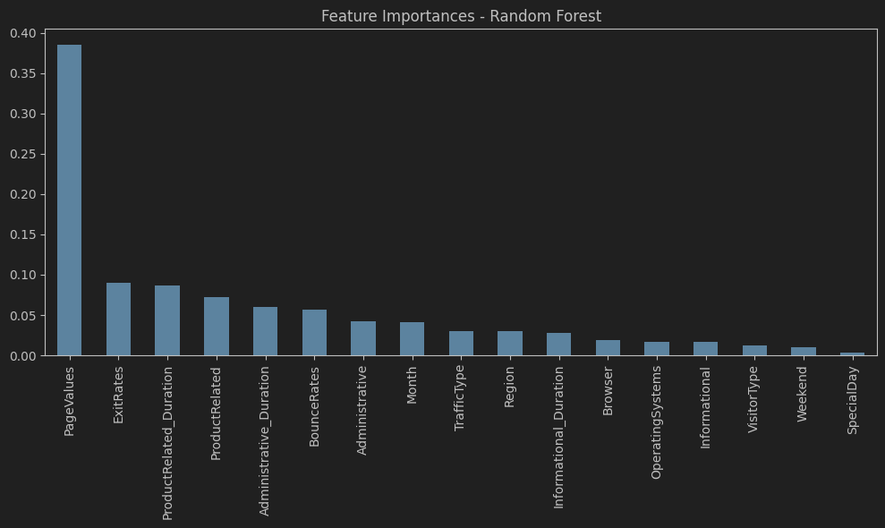
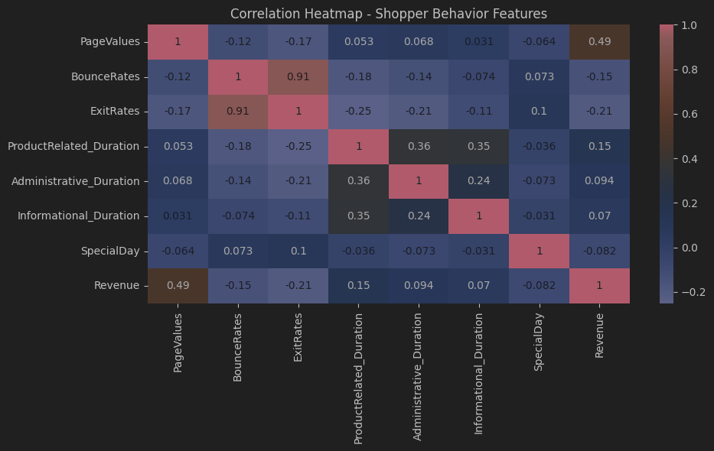
Advanced Models and Pattern Discovery
AI Avenger: Bao
Classification: RF (89%), MLP (87%), NB (84%)
Clustering: KMeans (K=3)
Cluster 0: High conversion (41.5%)
Association Rules:
PageValue > 0 & VisitorType = Returning → Revenue=True (95%)
Feature Selection: InfoGain & Wrapper → Top 7 features
Notes:
We began with K-Means clustering on key behavioral metrics like PageValues, BounceRates, and ProductRelated_Duration.
The chart on this slide shows how different clusters align with the likelihood of making a purchase.
Cluster 0, for example, includes high-value, engaged users and shows a much higher purchase rate.
In contrast, Cluster 1 contains short sessions and high bounce rates — these users rarely convert.
Next, we analyzed feature correlations, shown in the heatmap.
We found strong negative correlation between BounceRate and PageValues, and a positive link between PageValues and Revenue.
This reinforces that deep, engaged sessions are most likely to result in conversion.
We also applied association rule mining. One interesting rule we found:
Returning visitor + non-weekend + PageValue > 0 ⇒ Revenue = True
This had a confidence above 90%, highlighting a clear pattern for targeting and personalization.”

Slide 19
— Innovative Technique

Slide 20
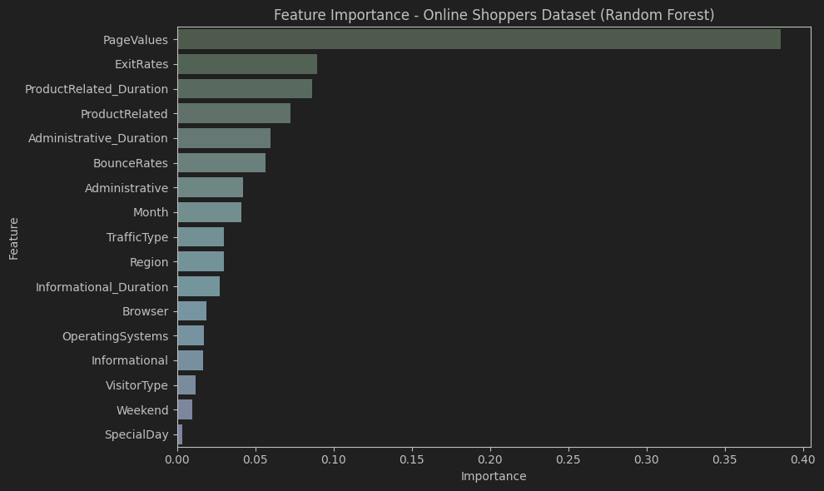
Hybrid Ensemble + Attribute Selection
AI Avenger: Bao
Features selected via Random Forest importance (9 out of 17)
Ensemble: Random Forest + Logistic Regression + MLP
VotingClassifier (soft voting)
Results:
Accuracy: 88.77%
Training time reduced by ~30%
Zhou, Z.-H. (2012). Ensemble Methods: Foundations and Algorithms. Chapman and Hall/CRC
Notes:
As you can see from the bar chart:
The top predictor is PageValues, which represents how much value the user gains from the pages they visit.
Next are ExitRates and BounceRates, both of which are negatively correlated with conversions — confirming that shorter, less engaged sessions rarely lead to sales.
ProductRelated_Duration also plays a big role, showing that time spent exploring product pages is a strong conversion signal.
Categorical features like VisitorType and Weekend were less influential but still contributed.
This insight helps businesses prioritize page experience optimization, especially on high-value product pages, to improve conversion rates.”

Slide 21
Hybrid Ensemble + Attribute Selection
AI Avenger: Bao
Features selected via Random Forest importance (9 out of 17)
Ensemble: Random Forest + Logistic Regression + MLP
VotingClassifier (soft voting)
Results:
Accuracy: 88.77%
F1 Score (for class=1): 0.5452
Training time reduced by ~30%
Model Summary
Selected Features:
Administrative, Administrative_Duration
ProductRelated, ProductRelated_Duration
BounceRates, ExitRates, PageValues
Month, TrafficType
Zhou, Z.-H. (2012). Ensemble Methods: Foundations and Algorithms. Chapman and Hall/CRC
Notes:
First, we applied model-based feature selection using Random Forest to reduce our input from 17 features to just 9 highly relevant ones.
This not only reduced overfitting but also sped up model training by over 30%.
Next, we combined three diverse classifiers:
Random Forest for robust learning
Logistic Regression for interpretability
Multi-Layer Perceptron for non-linear pattern detection
These were integrated into a VotingClassifier with soft voting, which averages their predicted probabilities.
The result?
88.77% accuracy
A balanced F1 score
And a model that’s both efficient and generalizable
This hybrid approach follows ensemble best practices from academic research and demonstrates how even basic models can be scaled and improved with smart integration.”

Slide 22
— Why This Technique Is Innovative?

Slide 23
Why? Smart, Scalable, Strategic
AI Avenger: Bao
Smarter Feature Use
Reduces noise and training time by using only the most informative 9 features
Based on Random Forest importance — not just correlation or filter methods
Hybrid Model with Diverse Strengths
Combines Random Forest (non-linear), Logistic Regression (linear), and MLP (neural)
Uses soft voting to fuse predictions intelligently
Balanced Tradeoff
Achieves 88.8% accuracy and stable F1 score, with 30% faster training
Suitable for real-world deployment, where speed + accuracy both matter
Grounded in Research, follows ensemble theory (Zhou, 2012): diversity among classifiers improves robustness
Practical Impact
Lower resource use, higher generalization
Clear path to deployment in e-commerce, digital marketing, or recommendation engines
Notes:
This technique goes beyond traditional classifiers by integrating thoughtful feature selection with a hybrid modeling strategy. First, we applied Random Forest-based importance scoring to retain only the most predictive 9 features. This step eliminated irrelevant data and significantly improved training efficiency, which is critical when working with large-scale session data like in e-commerce.
Next, instead of relying on a single classifier, we strategically combined three different types of models: Random Forest for its robustness and handling of nonlinear interactions, Logistic Regression for its speed and interpretability, and a Multi-Layer Perceptron to capture complex patterns in the data.
We then used a soft-voting approach to aggregate their predictions. This not only enhances accuracy but also smooths out the weaknesses of any single model, resulting in better generalization across user segments.
The outcome was impressive: we achieved an accuracy of nearly 89%, reduced training time by 30%, and preserved a balanced F1 score. What's important here is that the model is not only technically sound but also deployment-ready. It offers a strong blend of precision, speed, and real-world usability, especially for businesses looking to implement scalable AI-driven personalization or recommendation systems

Slide 24
— Key Findings & Recommendations

Slide 25
Key Conclusions
AI Avenger: Bao
Naïve Bayes is fast and interpretable, but underperforms in complex, multi-class datasets.
Ensemble models, especially Random Forest, provide superior accuracy in both tasks.
Hybrid model + feature selection improves efficiency without sacrificing predictive power.
In sentiment analysis, text preprocessing (TF-IDF + N-Grams) significantly boosts Naïve Bayes performance.
PageValue, BounceRate, and Product Duration are key predictors of online conversions.
Recommendations
Use Naïve Bayes for simple or real-time tasks, but prefer ensemble methods for accuracy-critical systems.
Apply feature selection in workflows to reduce overfitting and computational cost.
In e-commerce, optimize high PageValue sessions and retarget returning visitors mid-week.
Consider deploying hybrid ensembles for robust and scalable AI applications.
Notes:
To close our presentation, this slide highlights the key insights and our recommendations moving forward.
First, while Naïve Bayes offered speed and simplicity, its performance dropped in more nuanced classification problems. On the other hand, ensemble methods like Random Forest proved to be the most accurate across both health and behavioral datasets.
The hybrid ensemble model was especially effective: by selecting only the most informative features and combining diverse learners, we achieved high accuracy with reduced training time. In sentiment analysis, text representation really mattered—using TF-IDF and N-Grams led to the best results.
We also found that behavioral signals like PageValue and BounceRate were critical in predicting conversions. These findings have direct applications in digital marketing and e-commerce strategy.
So our recommendation is to use lightweight models only when simplicity is key, and otherwise adopt ensemble or hybrid approaches. Optimize your feature sets, focus your targeting efforts on returning visitors, and build scalable models that deliver both accuracy and efficiency.

Slide 26
References
Amin, M. Z., & Ali, A. (2017). Application of Multilayer Perceptron (MLP) for Data Mining in Healthcare Operations. 3rd International Conference on Biotechnology, Lahore, Pakistan.
Bhargavi, P., & Jyothi, S. (2009). Applying Naive Bayes Data Mining Technique for Classification of Agricultural Land Soils. IJCSNS International Journal of Computer Science and Network Security, 9(8), 117–122.
Gupta, B., Rawat, A., Jain, A., Arora, A., & Dhami, N. (2017). Analysis of Various Decision Tree Algorithms for Classification in Data Mining. International Journal of Computer Applications, 163(8), 15–20.
Heckerman, D. (1996). Bayesian networks for data mining. Data Mining and Knowledge Discovery, 1(1), 79–119.
Hu, W., Hu, W., & Maybank, S. (2008). AdaBoost-Based Algorithm for Network Intrusion Detection. IEEE Transactions on Systems, Man, and Cybernetics, Part B (Cybernetics), 38(2), 577–582.
Kataria, A., & Singh, M. D. (2013). A Review of Data Classification Using K-Nearest Neighbour Algorithm. International Journal of Emerging Technology and Advanced Engineering, 3(6), 354–359.
Komarek, P. (2004). Logistic Regression for Data Mining and High-Dimensional Classification. Carnegie Mellon University.
Peling, I. B. A., Arnawan, I. N., Arthawan, I. P. A., & Janardana, I. G. N. (2017). Implementation of Data Mining to Predict Period of Students Study Using Naive Bayes Algorithm. International Journal of Engineering and Emerging Technology, 2(1), 53–55.
Priyam, A., Abhijeet, A., Gupta, R., Rathee, A., & Srivastava, S. (2013). Comparative Analysis of Decision Tree Classification Algorithms. International Journal of Current Engineering and Technology, 3(2), 334–336.
Sharma, H., & Kumar, S. (2016). A Survey on Decision Tree Algorithms of Classification in Data Mining. International Journal of Science and Research, 5(4), 2094–2100.
Vembandasamy, K., Sasipriya, R. R., & Deepa, E. (2015). Heart Diseases Detection Using Naive Bayes Algorithm. International Journal of Innovative Science, Engineering & Technology, 2(9), 441– 447.
Wang, R. (2012). AdaBoost for Feature Selection, Classification and Its Relation with SVM: A Review. Physics Procedia, 25, 800–807.
Zhou, Z.-H. (2012). Ensemble Methods: Foundations and Algorithms. Chapman and Hall/CRC.

Slide 27
— Thanks For Listening!!!
Q&A

